Slide 1

The Justice Bot
#CourtHack 2017

Slide 2
Introducing the Team
Mehran Hosseinzadeh
Touseef Ikram
Joe Wheeler

Slide 3
Challenge Sets Addressed –
Wildcard! Closing Gaps in the Court System
Social Support for Families in Crisis
  Social media platform used to deliver tools and access expertise
Fairness: Leveling the Playing Field
  Explanation of process
  Maps for getting to court
Translating Legalese into Folksonomy
  Plain language bot with access to extensive legal glossary
Understanding Customer Experience
  Utilization statistics

Slide 4
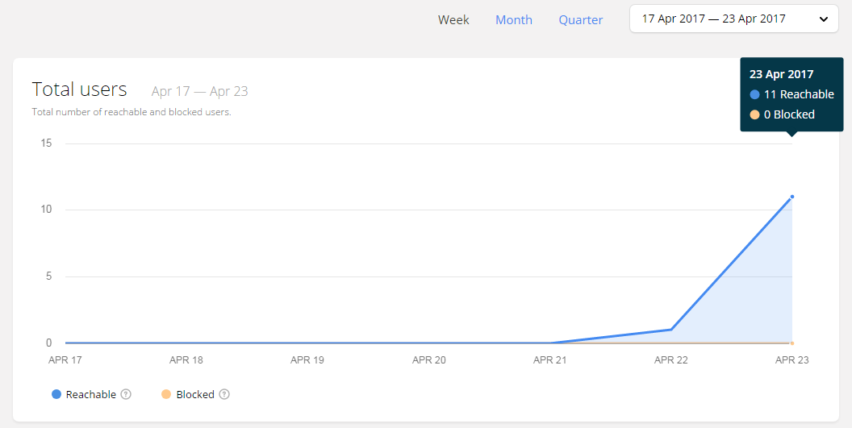
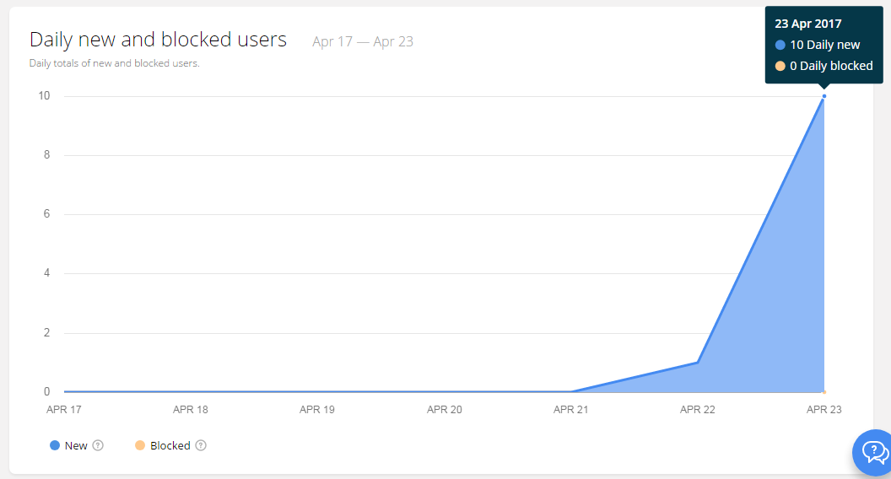
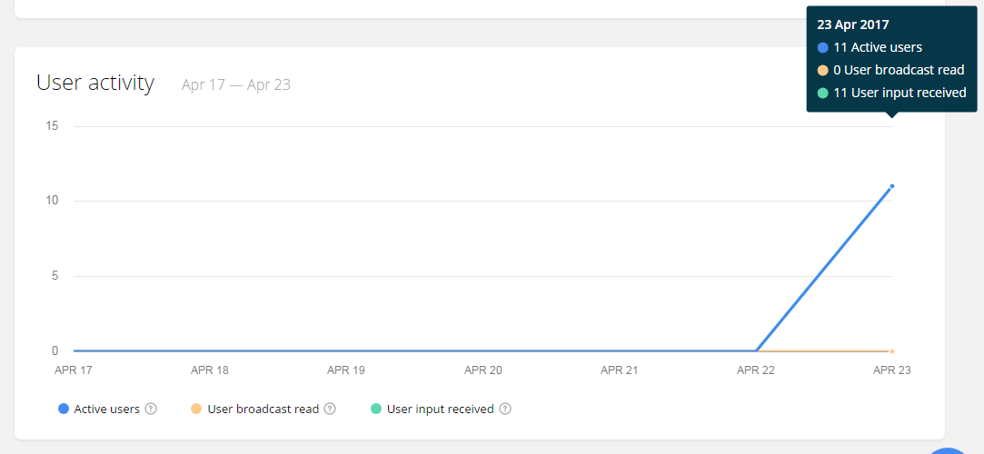
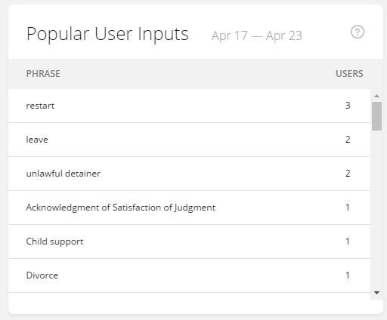
Toolset
  Facebook Messenger
  ChatFuel UI, NLP, AI
  Import.io to scrap 700+ legal terms and definitions to the bot.
  PHP/MySQL to

Slide 5
Resources
California Judicial Council
  Glossary
  Self-help resources
LA Superior Court Traffic Services Web Page (Feat. Gina)
  Citation payment
  Scheduling a hearing
California Department of Child Support Services
  Child support calculator
California State Bar
  Lawyer referral
Avvo
  Lawyer referral
  Question and answer service

Slide 6
Future Enhancements
Add other states
Integrate more APIs
  Fee calculators
  Maps / Floor Plans
Transition to more sophisticated bot platform
Add a pay wall for monetization
  Move some features behind pay wall
  Add value added feature behind the pay wall

Slide 7
Demostration

